Slide 1

Authors: Gamma, Helm, Johnson, Vlissides
Presented By: Tim Kramp

Slide 2

Christopher Alexander – Late 1970s.
  The patterns movement
Software engineers
  Discussing design patterns in late 1980s.
  Design pattern conferences in 1994.
Design patterns provide tested, proven development paradigms.

Slide 3

Allows treating complex and primitive objects uniformly
Compositions of objects and individual objects
4 main parts:
  Component
  Leaf
  Composite
  Client

Slide 4

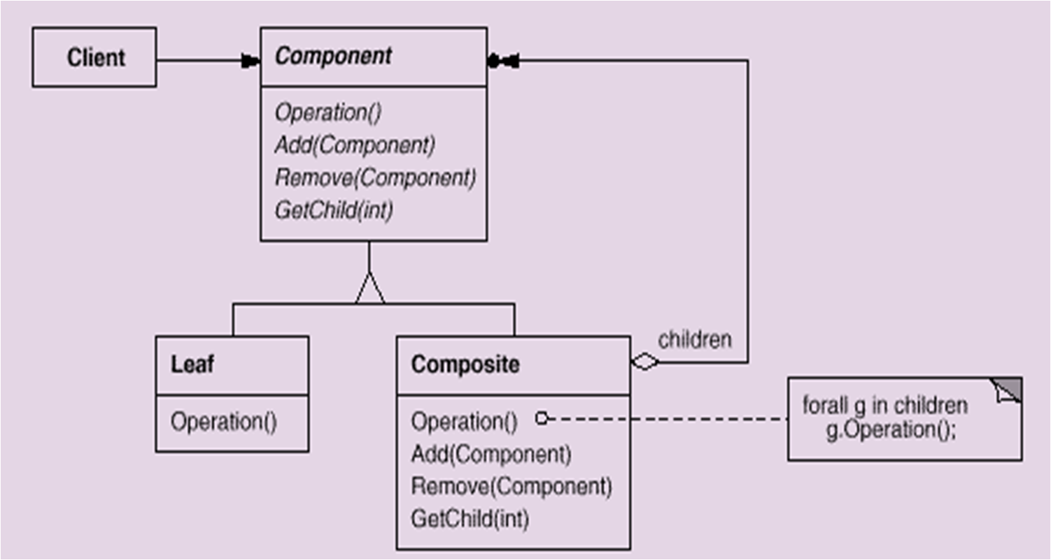

Slide 5

Makes the client simple
Makes it easier to add new kinds of components
Can overly generalize the design

Slide 6

Allows new & additional behavior to be added to an existing class dynamically
Alternative to Subclassing
4 Main Parts
  Component (Visual Component)
  Concrete Component (Text View)
  Decorator
  Concrete Decorator (Border decorator, Scroll Decorator)

Slide 7

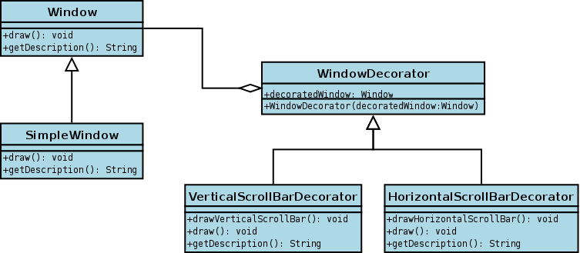

Slide 8

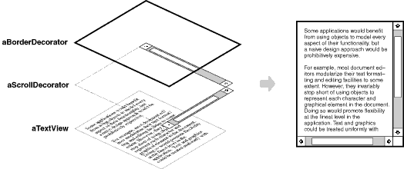

Slide 9
More flexibility than static inheritance
Avoids feature-laden classes high up in the hierarchy
A decorator and its component aren’t identical
Lots of little objects

Slide 10

Many different design patterns
  Each design pattern has their specific applications
  There are advantages and disadvantages to each one
Composite design pattern – multiple objects with similar functionality
Decorate design pattern – additional functionality dynamically instead of statically

